Slide 1
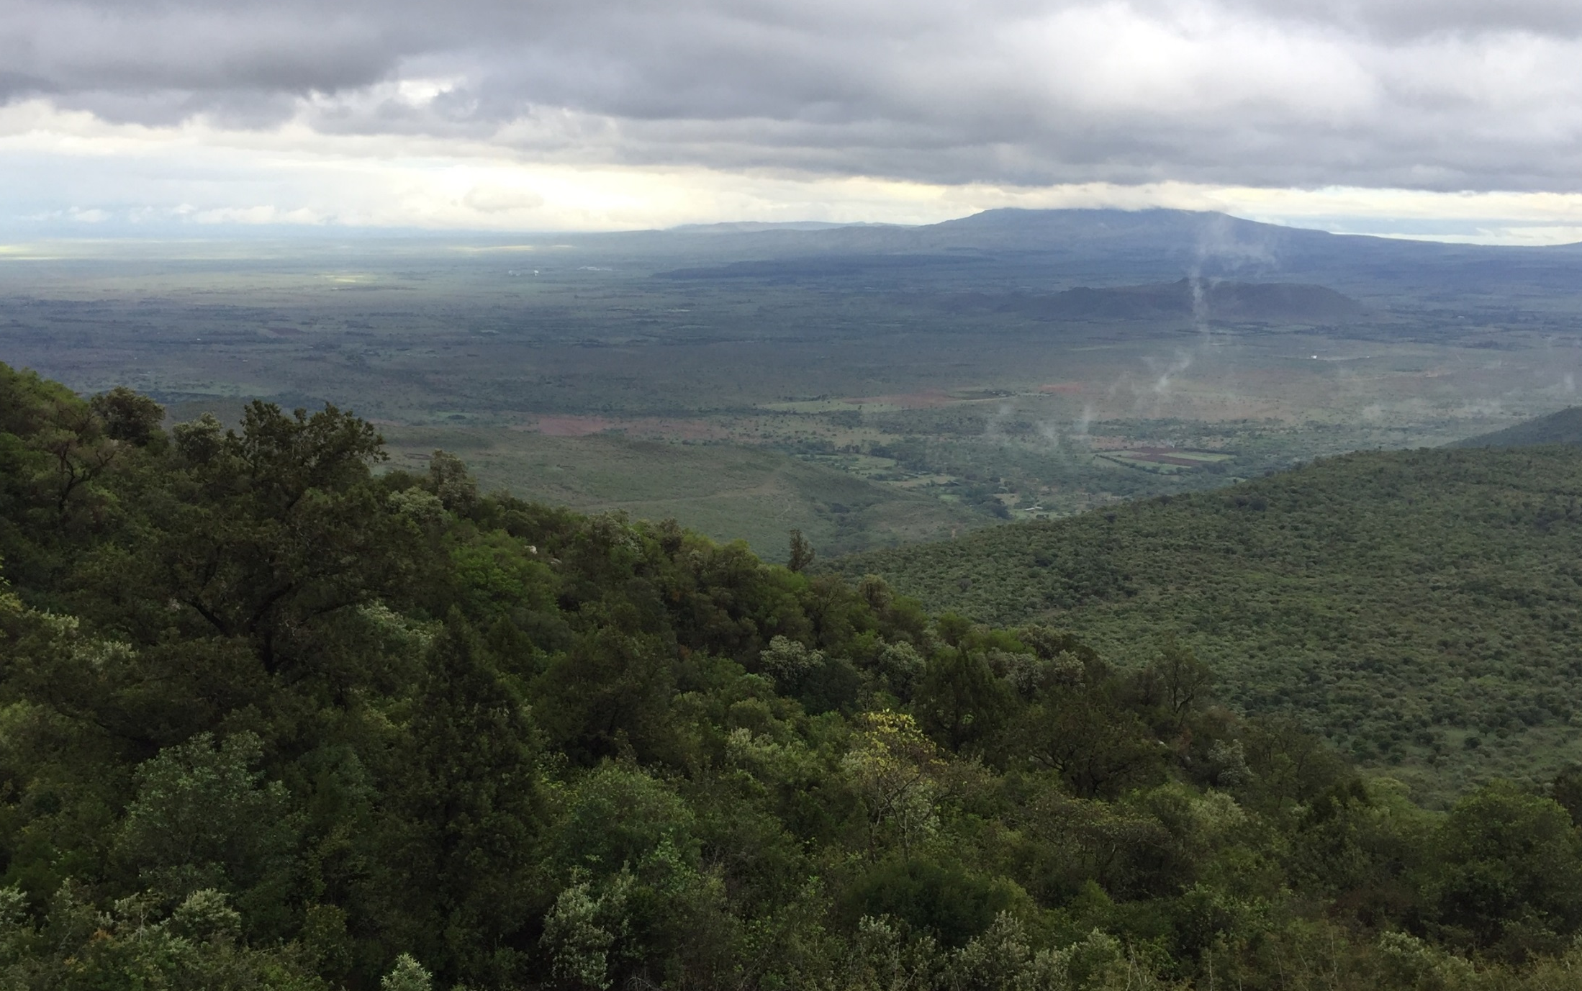
Social science research methods
A training course offered by the
Development Corridors Partnership
March 18th and 19th 2019, Nairobi
Notes:
You can customise the images on the title and end slides - we suggest using your own images or those free to use (CC0 Creative Commons) on pixabay.com or unsplash.com

Slide 2



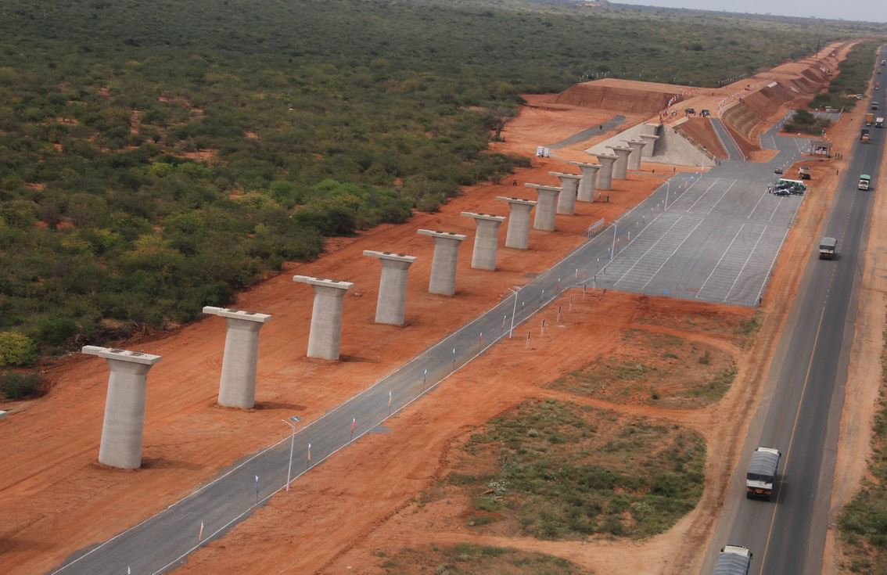
Overall Research Question: How can development corridors be designed and implemented to maximise their delivery of sustainable, inclusive and resilient economic growth?
The Development Corridors Partnership
Working with decision makers (public &
private) to influence development corridor design and implementation
Scientific advancement and capacity building on
how to maximise long term social and economic
benefits of development corridors without
undermining ecological integrity
Learning
Influence China and UK overseas investment decision making to contribute to sustainable development of growth corridors in the context of the Belt and Road initiative
Lead organisation: UNEP-WCMC. Principal investigator: Professor Neil Burgess

Slide 3
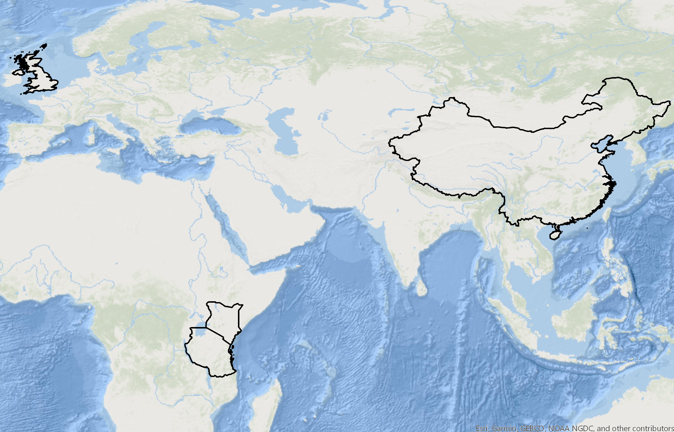











The partnership
Notes:
Introduce self. And who represent e.g. UNEP-WCMC and other organisations.

Slide 4
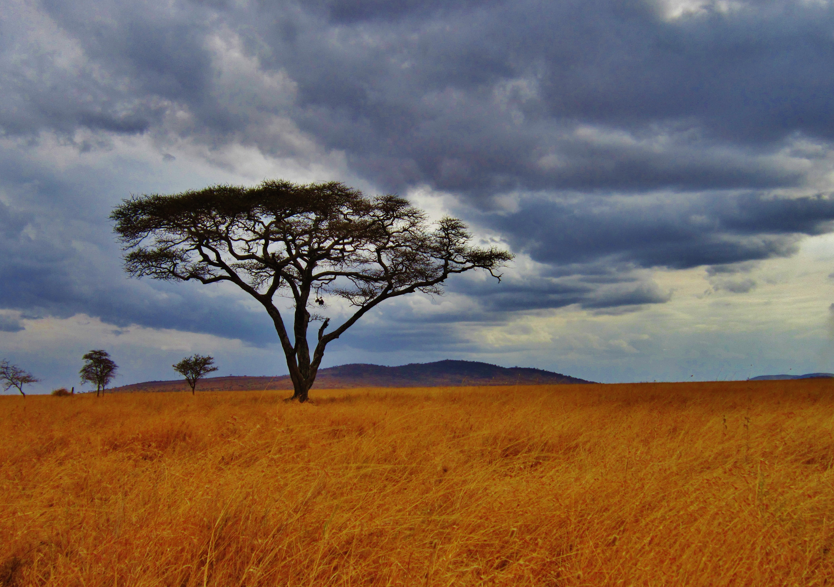

info@developmentcorridors.org
http://developmentcorridors.org
@devcorridors
Notes:
You can customise the images on the title and end slides - we suggest using your own images or those free to use (CC0 Creative Commons) on pixabay.com or unsplash.com
Right click > format background

Slide 5
Introductions
What is your name?
What is your role?
What is your academic disciplinary background (e.g. natural science, social science, a mixture, something else)
Why do you want to learn more about social science?
What are your expectations for the training?

Slide 6
Outline of the two days
08:00-8:45 | Registration and morning coffee
08:45-9:00 | Welcome, and training objectives, expectations, outcomes | Dr Gedis Lesutis
9:00-11:00 | Social science research: general introduction | Dr Chris Sandbrook
11:00-11:30 | Coffee break
11:30-13:00 | Household surveys: Part 1: Basic Theory of Household surveys | Dr Tobias Nyumba
13:00-14:00 | Lunch Break
14:00-16:30 | Household surveys: Part 2: Survey organisation | Dr Tobias Nyumba

Slide 7
Outline of the two days
08:15-9:00 | Registration and morning coffee
9:00-11:00 | Participatory modelling of social-ecological systems: Part 1 | Dr Jessica Thorn
11:00-11:30 | Coffee break
11:30-12:30 | Participatory modelling of social-ecological systems: Part 2 : Participatory scenario planning | Dr Jessica Thorn
12:30-13:30 | Lunch Break
13:30-16:00 | Qualitative research: understanding “data” and “fieldwork encounters” | Dr Gedis Lesutis
16:00-16:20 | Coffee Break
16:20-17:00 | Research ethics | Dr Chris Sandbrook
17:00-17:30 | Closing remarks and awarding certificates of participation

Slide 8
Introducing social science research
Dr Chris Sandbrook
University of Cambridge
Notes:
You can customise the images on the title and end slides - we suggest using your own images or those free to use (CC0 Creative Commons) on pixabay.com or unsplash.com

Slide 9
Outline of the session
What is social science?
The role of social science in conservation and development
Fundamental issues in social science:
  Deductive and inductive research
  The qualitative / quantitative divide
  Alternative underlying philosophies
  Methodology and methods
The value, and challenge, of interdisciplinarity
Illustrated with a case study throughout

Slide 10
What is social science?
“The scientific study of human society and social relationships” (Oxford English Dictionary)
Includes multiple disciplines, each with it’s own specialism and approach
Sometimes divided into ‘classic’ (e.g. anthropology), and ‘applied’ (e.g. development studies)
Social scientists study a wide range of social phenomena, social processes and individual attributes

Slide 11
Bennett et al. (2017) Biological Conservation 205: 93-108

Slide 12
What is social science?
Social scientists work at a wide range of scales

Slide 13
Bennett et al. (2017) Biological Conservation 205: 93-108

Slide 14
The role of social science in conservation and development
Conservation issues (e.g. biodiversity loss) occur because of the actions of people
Development is about the wellbeing and livelihoods of people
Both fields are therefore inescapably social. To understand what is happening and improve the situation social science is needed
However, most conservationists have a background in biology. This is useful, but not enough
There is widespread agreement that more social science capacity is required
Notes:
Ask them how many have a background in biology or natural sciences?

Slide 15
The role of social science in conservation and development
What purposes can social science play for conservation and development?
  Instrumental
    e.g. working out an effective strategy to change behaviour
  Descriptive
    e.g. a historical account of conservation and development in Kenya
  Reflexive
    e.g. asking critical questions about how development is framed & justified
  Generative
    e.g. coming up with innovative concepts and practices

Slide 16
The role of social science in conservation and development
Social science is not always intended to be ‘useful’ or ‘for’ conservation and/or development
Social scientists often brought in late for an instrumental purpose
This undervalues their potential contribution
“social scientists are problem formulators, data collectors, analysts, and theory developers who can provide insights that can guide the social processes associated with conservation [and development]” (Bennett et al. 2016 Conservation Biology 31:56-66)
Different conservation / development social science disciplines play different roles

Slide 17
Bennett et al. (2017) Biological Conservation 205: 93-108

Slide 18
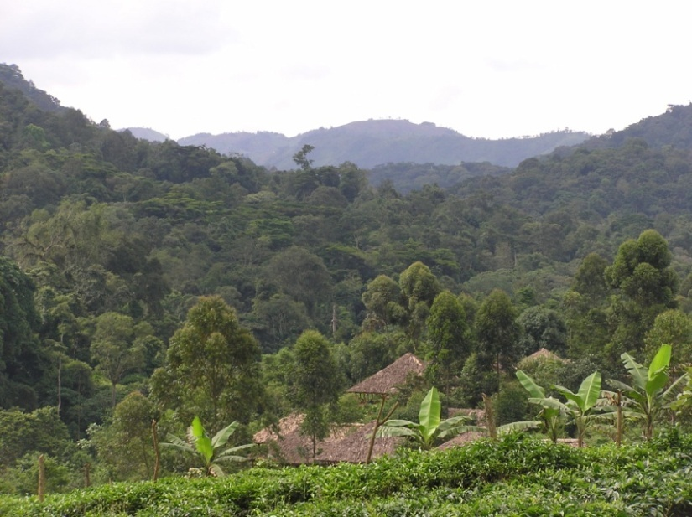
A case study: Researching tourism impacts at Bwindi Impenetrable
National Park, Uganda

Slide 19
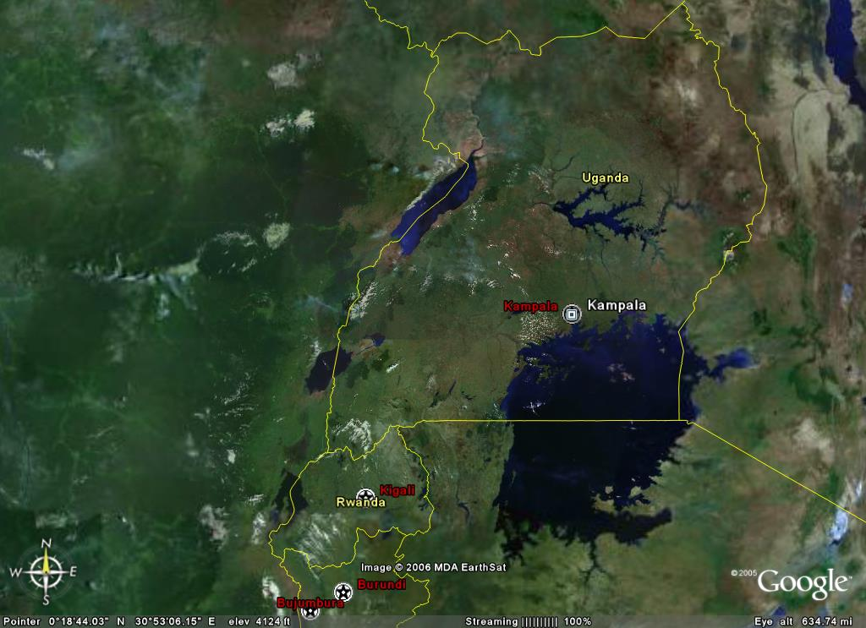
Bwindi Impenetrable National Park, SW Uganda
Notes:
The LOGO slide can be used to open and close presentations. It may also by used as a handover/holding slide between presentations.
This slide does not include the option of changing or adding text.
The TITLE slide has placeholders for the presentation title and subhead details; presenter name, date, location, etc. You can use this to create your own title slides. This slide can also be adapted for use as a section divider, relating to the agenda.
The TEXT slides have a pre-determined style, which may or may not include bullet points. The guides illustrate the limits to which the text fills the screen. A text box has been formatted and placed for References or Notes (bottom left), this can be copied and pasted from slide to slide.
The PRESENTATION TEMPLATE slide has been set-up with a pre-formatted style and colour scheme. Placeholders control the appearance and position of the following PowerPoint elements; title, text, bullets, charts and graphs (see details below). Header and footer information placeholders are included in the slide master to control slide number, time, date and information presented. These can be turned on and off at will, but will only printout/appear in black and white.
The Header and Footer information fields are accessed from the VIEW menu under the Header and Footer, see details below. The tick boxes turn the headers and footer on, allowing the input of information.
Presentation template guide.

Slide 20
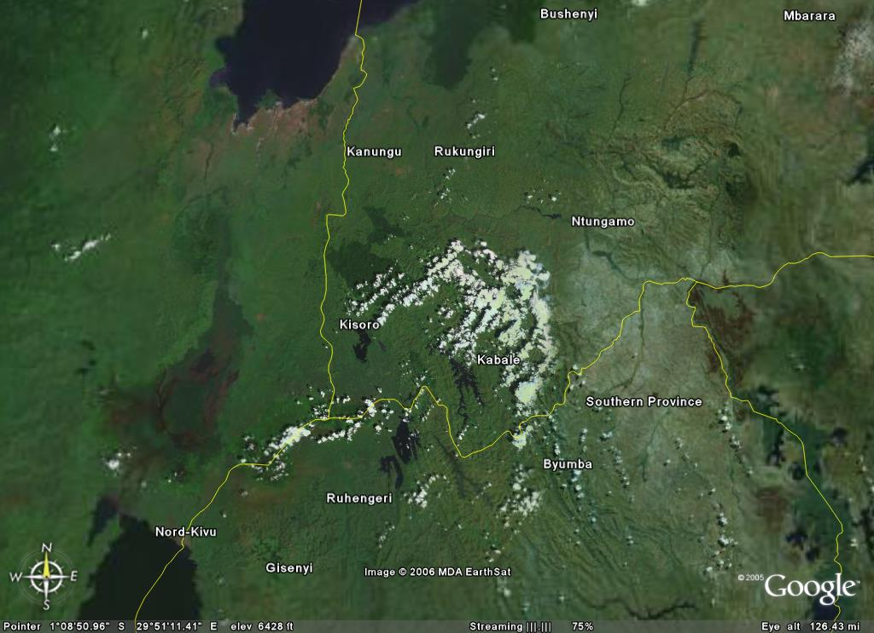
Bwindi NP

Slide 21
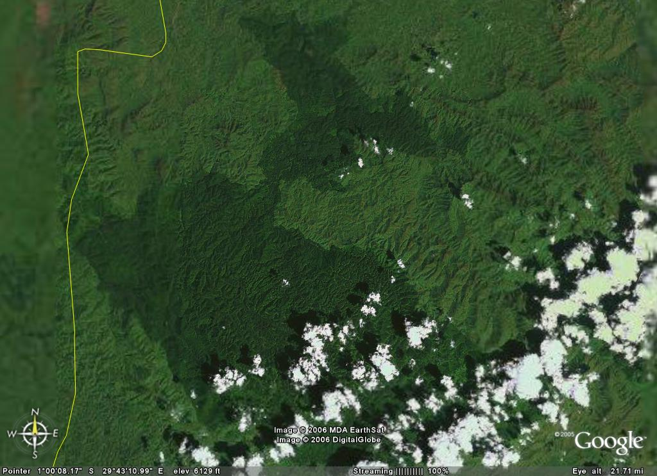
Park HQ

Slide 22
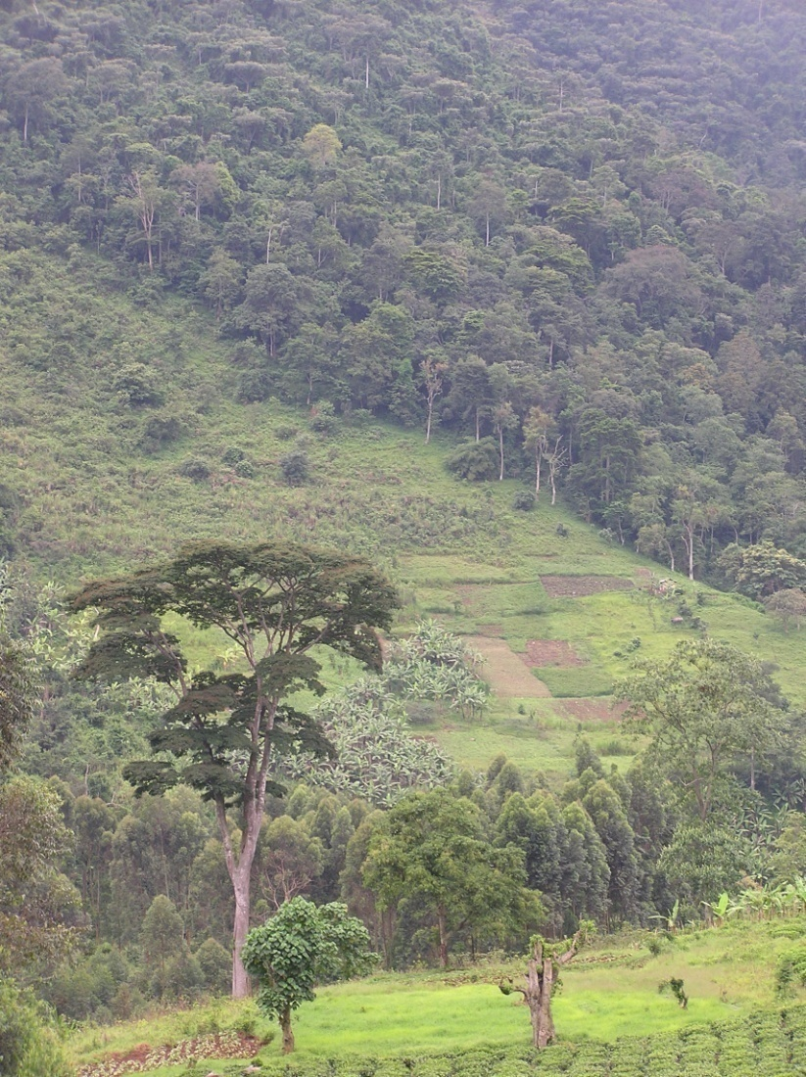
Bwindi Impenetrable National Park
Established as a National Park in 1991
Previously a forest reserve with limited protection
Surrounded by a dense human population – ‘an island of habitat’
Extensively degraded during 70s and 80s
Considerable conflict after 1991
  Fires started
  Conflict with park staff
  “When you mention the national park we want to vomit.”
Decided to adopt a policy of Integrated Conservation and Development (ICDP)
  Incentives for local people rather than punishments
Hamilton A, et al. (2000) Conservation in a region of political instability: Bwindi Impenetrable forest, Uganda. Conservation Biology 14: 1722-1725.
Baker J, Milner-Gulland, E.J. & Leader-Williams, N. (2012) Park gazettement and integrated conservation and development as factors in community conflict at Bwindi Impenetrable Forest, Uganda. Conservation Biology 26: 160-170

Slide 23
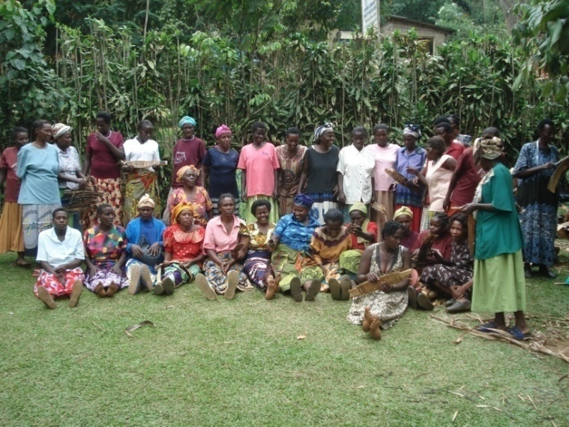
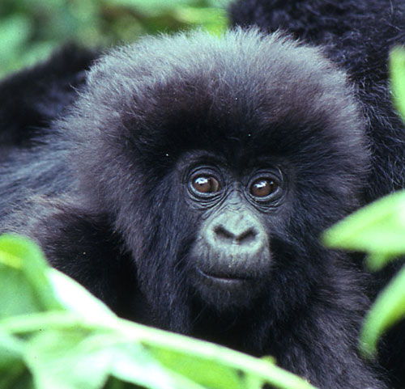
Mountain gorillas at Bwindi
Bwindi has about half the world population of mountain gorillas (total is ~ 880). Most groups habituated for tourism (10)
Tourism central to ICDP at Bwindi
Tourists pay $600 US per day to visit the gorillas for 1 hour, in groups of 8 ($1500 in Rwanda!)
~$20 goes to local community, the rest to Uganda Wildlife Authority for park costs
Tourist numbers are limited to reduce risk of disease transmission. Also various other rules to minimise risk
Most tourists stay in luxury lodges
An iconic site for ‘ecotourism’ – an ideal place to explore optimistic and critical views
Photo © C. Sholler

Slide 24
Meet our two researchers
Two imaginary researchers are going to do independent studies at Bwindi
Both are interested in the impacts of gorilla tracking tourism for conservation and development
Both wants to understand role of tourism income in shaping natural resource use behaviour
Jane
  Has a background in social psychology
  Wants to improve conservation outcomes
  Has a new intervention she wants to test
John
  Has a background in anthropology
  Wants to build up a rich understanding of local culture and how tourism fits within it
  Is interested in how local people came to be framed as a ‘problem’
What kind of research are they each doing?
Instrumental
Descriptive
Reflexive
Generative

Slide 25
Fundamental issues in social science
Social science has several characteristics than (can) make it different from natural science
1. Deductive versus Inductive research
Deductive
  The researcher comes up with a hypothesis based on theory
  Then designs a strategy to test it – often experimental
  Using quantitative data and statistical significance testing
  If the null hypothesis is rejected, the theory is (possibly) correct
  Often called ‘the scientific method’
  Useful for examining cause-effect relationships

Slide 26
Fundamental issues in social science
Inductive
  No specific hypothesis – just broad questions or issues
  Data are collected and used to generate theory
  Extreme form is ‘grounded theory’ – researcher has a completely open mind with no pre-conceived ideas
  Inductive research can be useful where there is little idea of what might be happening in the study system
  Also useful for building up an in-depth understanding of complex systems that cannot be broken down into simpler parts
Both inductive and deductive research feature in social science and each suit particular situations

Slide 27
Meet our two researchers
Jane
  Has studied a theoretical model of human behaviour
  Has an idea to improve the theory
  The idea generates a new hypothesis – if tourism income is received alongside some environmental education, it will be more likely to change resource use behaviour
  Designs an experiment to test it – some people
  get the training, others don’t
John
  Has an open mind and no specific research questions
  Sees the current situation as the product of complex
  interacting issues – history, politics, power relations, culture, economic relations, etc.
  Believes he can’t say anything useful about tourism impacts without a rich understanding of this broader context
  Plans to study the system and then build theory to explain his findings
What kind of research are they each doing?
Inductive
Deductive

Slide 28
Fundamental issues in social science
2: The quantitative / qualitative divide
Two stages: Data and analysis
  Quant data are numbers. Qual data are text & images (usually)
  Quant analysis is statistics. Qual analysis is diverse
Qual/quant can be a source of tension:
  Quantitative researchers can see qualitative data as ‘anecdote’ and lacking in solid answers
  Qualitative researchers can see quantitative data as too simplistic and narrow
Those with natural science training usually favour the quant approach

Slide 29
Meet our two researchers
Jane
  Plans to collect numerical data measuring the flows of tourism income, the attitudes of local people and their behavioural intentions
  Plans to conduct statistical analysis of the data to reveal relationships between her educational intervention and behavioural outcomes
John
  Plans to collect images, and text from interviews, notes and documents
  Plans to analyse this material to build up narrative descriptions of the study system and the role of tourism within it
What kind of research are they each doing?
Qualitative
Quantitative

Slide 30
Fundamental issues in social science
3: Alternative underlying philosophies
Preferences for quant / qual data etc. can reflect differences in underlying beliefs
Ontology: What is the nature of reality?
  Realism: There is one true external reality
  Relativism: Realities are mental constructions
Epistemology: How do we create knowledge?
  Objectivism: Meaning exists within an object independent of the researcher
  Constructivism: Meaning created from interplay between object and researcher
  Subjectivism: Meaning only exists within the researcher

Slide 31
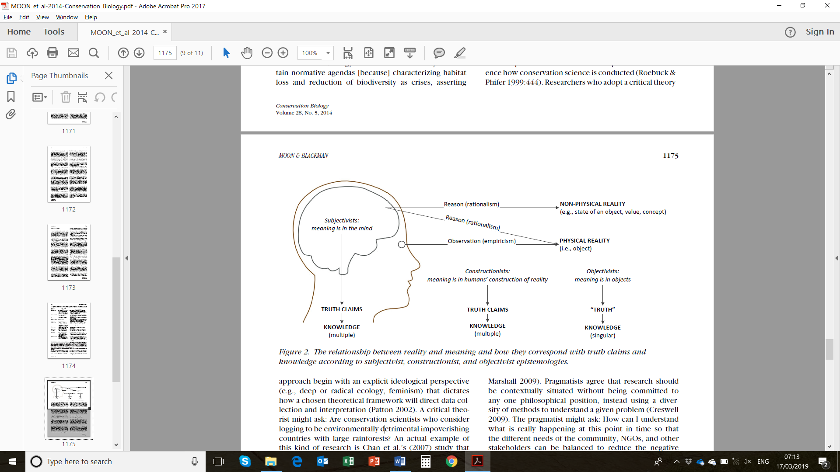
Moon & Blackman (2014) Conservation Biology 28:1167-1177

Slide 32
Fundamental issues in social science
Most natural science research is realist and objectivist – assumes there is an external reality that can be studied directly by scientific methods
Some social science disciplines follow this model – e.g. psychology, economics
Others take a different view – e.g. anthropology
Argue that studying humans is different from studying anything else:
  The researcher is part of the social system they are studying and cannot observe it ‘objectively’
  People have their own ideas and interpretations which are part of the social world being studied – e.g. ‘wilderness’

Slide 33
Meet our two researchers
Jane
  Believes that there is a single reality that is external to the human mind
  Believes that she can measure this truth using her research methods
  Seeks to keep herself separate from the study system as far as possible to maintain objectivity and avoid influencing her respondents
John
  Believes that there is no reality external to the human mind. ‘Reality is in the eye of the beholder’
  Believes that meaning emerges from the interplay between himself as the researcher and the human and non-human entities he is studying
  Sees himself as part of the study system – he cannot separate himself from it. Seeks to be reflexive about his influence and how he is perceived
What kind of research philosophies do they hold?
Realism or relativism?
Objectivism, constructivism or subjectivism?

Slide 34
Fundamental issues in social science
4: Methodology and methods
Methodology “provides a rationale and overarching framework for undertaking a programme of research”
  E.g. experimental, ethnographic, action resarch
Methods are “tools of data collection and analysis”
  E.g. interviews, surveys, participant observation
Methodology shapes research design – methods are the doing phase
There are many methodologies and methods – this training course will only cover a few key examples

Slide 35
Meet our two researchers
Jane
  Using an experimental methodology to understand the influence of a specific intervention
  Collecting data using household surveys, tourist surveys and biophysical measurements of resource use behaviour
  Trying to manipulate the study system from outside in order to see how it responds
  John
  Using an ethnographic methodology to gain a detailed understanding of the complex interplay between various actors and processes
  Collecting data using participant observation, open ended interviews, archival and document analysis
  Trying to become part of the study system in order to fully understand it

Slide 36
The value, and challenge, of interdisciplinarity
Many issues in conservation and development are highly complex
It can be valuable to use more than one disciplinary perspective
Interdisciplinarity: “the quality or fact of involving or drawing on two or more branches of knowledge” (OED)
This comes in various forms:
  Multidisciplinary: two or more disciplines used in parallel
  Interdisciplinarity: more integrated – perspectives inform one another
  Transdisciplinarity: transformative merging of approaches to create new ones

Slide 37
The value, and challenge, of interdisciplinarity
Interdisciplinarity sounds great but is hard to do well!
Getting good at multiple disciplines is very time consuming and challenging
So easier to work in teams with various skills?
But: people from different disciplines can find it difficult to understand each other
Basic requirement is that people respect those in other disciplines and know enough to understand where they are coming from
  This is one of the main aims of this training course!

Slide 38
Meet our two researchers
Jane and John meet in a bar early in their fieldwork
They realise that they are working on very similar topics that could be complementary
Jane can find out something about the specific impact of an important change in the study system (her educational intervention)
John can set this into the wider context of the social-ecological system
Jane identifies a quantitative pattern but can’t necessarily explain it
John’s research doesn’t reveal the pattern but can explain the causal relationships
They decide to conduct a mixed methods study together
What kind of research are they doing?
Multidisciplinary
Interdisciplinary
Transdisciplinary

Slide 39
A final exercise
Working in groups, come up with a research topic relevant to your own work and interests
  Think about the appropriate approach for researching your topic:
    Instrumental? Descriptive? Reflexive? Generative?
    Inductive or deductive?
    Qualitative or quantitative?
    Philosophical approach (if you have time)
  Why would you make these choices?
  Don’t worry about choosing methods – we will look at these later in the training
  Be prepared to share your ideas with the group

Slide 40
Conclusions
Social science has a crucial role to play in conservation and development research and practice
Can work well in combination with natural science disciplines through interdisciplinary research
Social science can differ from other forms of research in several ways
  Inductive as well as deductive
  Qualitative as well as quantitative
  Different underpinning philosophies
These can act as a barrier to understanding and collaboration

